Slide 1
Data Engineering Capstone Project-1
Created by – Akshi Sharma

Slide 2
Table of contents
Business objective
Data used & description
Technology stack used
ER Diagram (data model)
Outputs for different analysis (EDA & ML Model)
Challenges faced

Slide 3
Business objectives
Create a data engineering solution to an HR employee data by formulating an end-to-end pipeline for better understanding
Exploratory Data Analysis of provided Data Set.
Using the data set to come up with meaningful insights.
Using Machine Learning to come up with the various reasons for the employees leaving the company.

Slide 4
Data used & description
The Following data were used to perform the desired outcomes (All data files were provided in csv format by the organization)
Titles (titles.csv)
Employees (employees.csv)
Salaries (salaries.csv)
Departments (departments.csv)
Department Managers (dept_manager.csv)
Department Employees (dept_emp.csv)

Slide 5








Technology stack used
The following techstack was used to meet the project goals:
MySQL (to create database)
Linux Commands
Sqoop (Transfer data from MySQL Server to HDFS/Hive)
HDFS (to store the data)
Hive (to create database)
Impala (to perform the EDA)
SparkSQL (to perform the EDA)
SparkML (to perform model building)

Slide 6
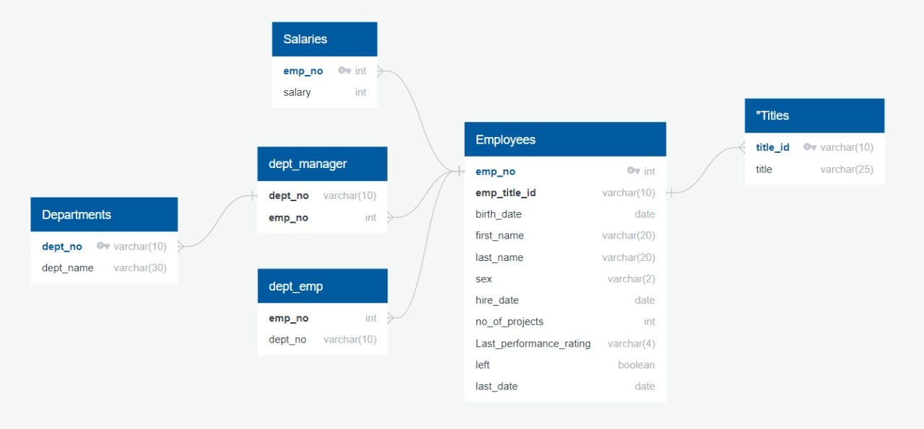
ER-Diagram (data model)

Slide 7
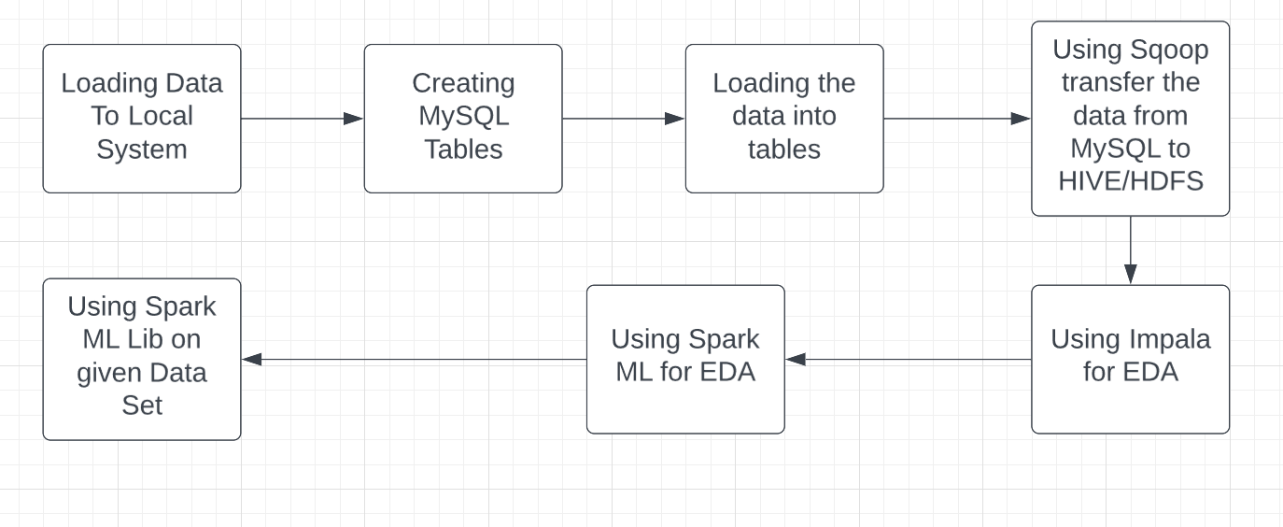
Architecture Pipeline

Slide 8
Data flow description
All csv given by the client were upload to a Linux based cloud system.
All the csv were converted into SQL database tables with following attributes as mentioned in slide 5 and 6.
Using Sqoop as a middleware we transferred all Tables data as Avro files into HDFS
Using scoop as a middleware all files were convert into Avro file to import all tables to HDFS.
Using HDFS (copyFromLocal) we transferred Avro Schema files to hdfs
We created Hive tables and loaded Avro files data into it
Then using Hive tables we performed EDA in Impala and Spark SQL
Using Pyspark Dataframes we did ML Model Building
And created ML Pipelines

Slide 9
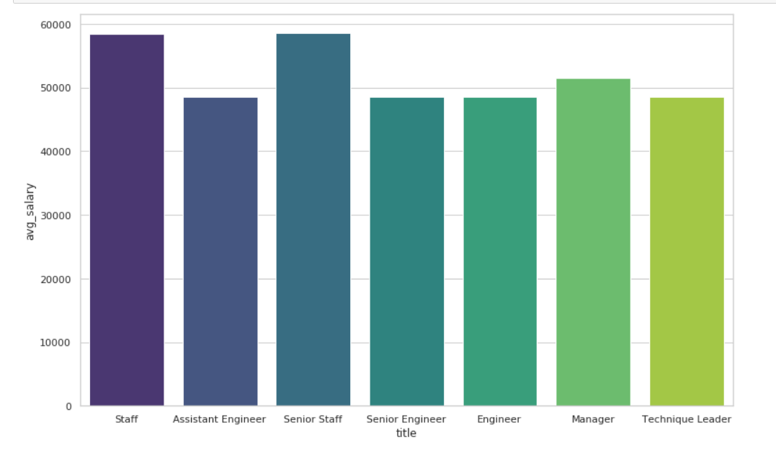
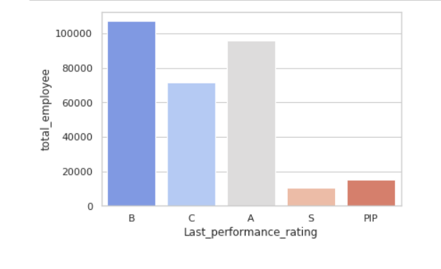
Output of EDA
Average of Salary Per Title
Count of employees based on Rating

Slide 10
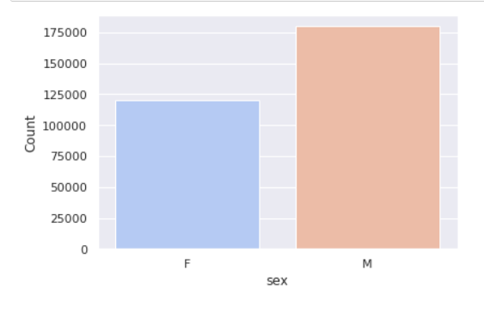
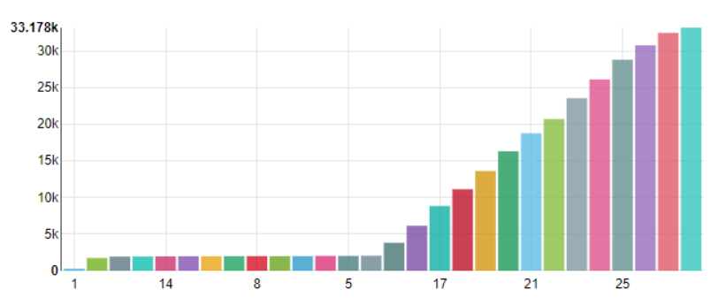
Output of EDA
Tenure Distribution Among Employees
Employee Gender Distribution

Slide 11
Output of ml model
Accuracy | 0.9002268488178656
Error | 0.09977315118213437
Precision | 0.8104083793325443
Recall | 0.9002268488178656
F1 | 0.8529596135710857

Slide 12
Challenges faced
Importing Data from Local to MySQL.
Data Transfer using SQOOP.
Using ML Lib for Machine Learning.
Creating Pipeline

Slide 13
Steps ahead
The analysis can be used by the company to access its employee retention.
The analysis can be used to find out the reasons why employees are leaving the company.
The reasons found out may be used to rectify the problems.
Will also have a detail overview of manpower expenditure made by the company in those years, giving us a full overview on expenditures made by the company in the following years with adjustment in manpower and inflation rates respectively.
We will have a detail description of employees working in different departments to fulfil working needs of the organization hence giving us a overview of net manpower consumption for organization to perform its workflow.

Slide 14
Thank you

